Slide 1
Introduction to Pentium Processor

Slide 2
Features of Pentium Processor
Separate instruction and Data caches.
Dual integer pipelines i.e. U-pipeline and V-Pipeline.
Branch prediction using the branch target buffer (BTB).
Pipeliened floating point unit.(a part of a computer system specially designed to carry out operations on floating-point numbers)
64- bit external data bus.
Even-parity checking is implemented for data bus, caches and TLBs(A translation lookaside buffer (TLB) is a memory cache that stores the recent translations of virtual memory to physical memory).

Slide 3
Salient Features
32- bit Superscalar and super-pipelined architecture CISC processor.
32-bit address bus can address up to 4GB of physical memory.
64- bit data bus so arithmetic and logical operation can be perform on 64-bit operand.
Two integer pipeline U and V with two ALU’s provide one-clock execution for core instructions which Improved Instructions to execute Time.

Slide 4
Support five stage pipeline enables multiple instructions to execute in parallel with high efficiency.
Two 8 KB caches memories, one for data and other for code.
On- chip pipelined floating point coprocessor.
Support power management feature i.e. System Management mode and Clock Control.
Enhanced branch prediction buffer.
On-chip memory management unit.
Support multiprogramming and multitasking.

Slide 5
Internal error Detection features.
4MB pages for increased TLB Hit Rate.
Support for Second level cache and Write Back MESI (Modified, Exclusive, Shared, Invalid) Protocol in the data cache.
Supports Bus cycle Pipelining, Address Parity and Internal Parity Checking, Functional Redundancy checking, Execution Tracing, Performance Monitoring.

Slide 6
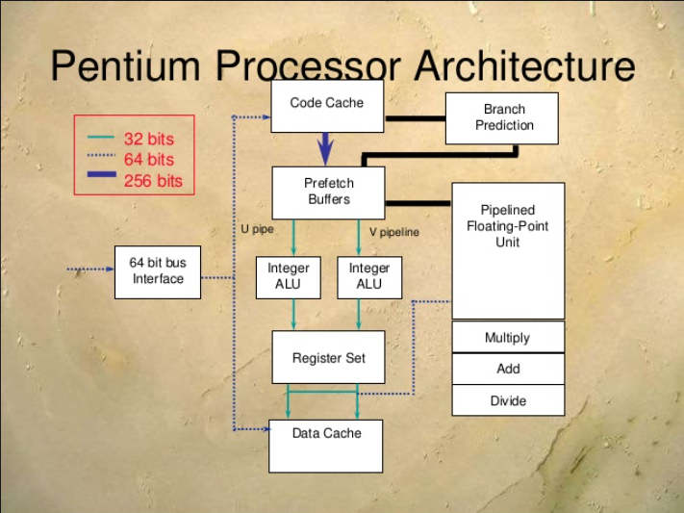

Slide 7
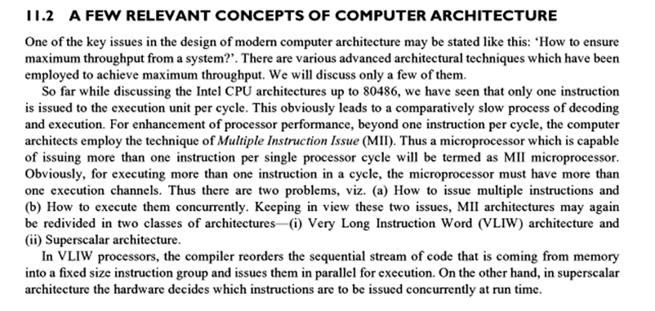
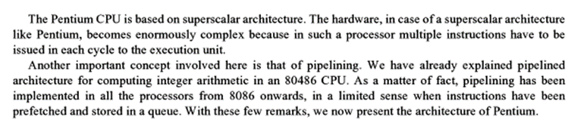

Slide 8
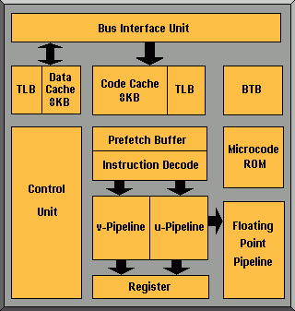
Pentium

Slide 9
Superscalar Execution
It supports superscalar pipeline architecture.
The Pentium processor sends two instructions in parallel to the two independent integer pipeline known as U and V pipelines for execution of multiple instructions concurrently.
Thus, processor capable of parallel instruction execution of multiple instructions is known as Superscalar Machine.

Slide 10
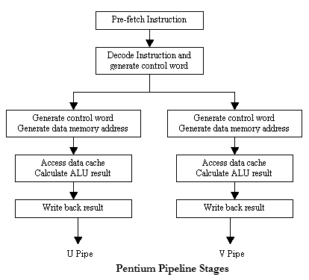
Each of these pipeline i.e. U and V, has various stages of execution i.e.
Prefetch
First Decode
Second Decode
Execute
Write Back

Slide 11
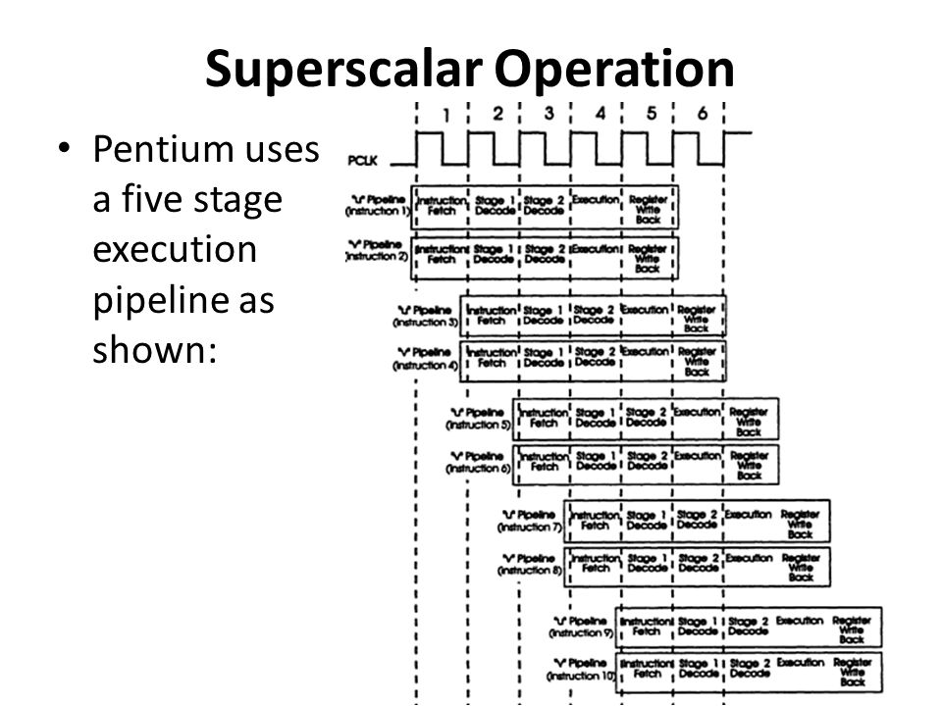

Slide 12
Pre-fetch (PF): In this stage, instructions are prefetched by prefetch buffer through U and V pipelene from the on-chip instruction cache.
First Decode (D1): In this stage, two decoders decode the instructions to generate a control word and try to pair them together so they can run in parallel.
Second Decode (D2): In this stage, the CPU decodes the control word and calculates the address of memory operand.

Slide 13
Execute (EX): The instruction is executed in ALU and data cache is accessed at this stage. For both ALU and data cache access requires more than one clock.
Write Back (WB): In this stage, the CPU stores result and update the flags.

Slide 14
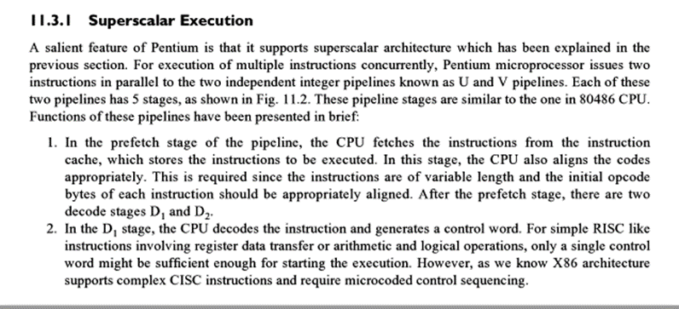
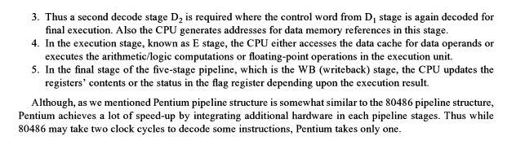

Slide 15
Separate Code and Data Caches:
Pentium has two separate 8KB caches for code and data as the superscalar design and branch prediction need more bandwidth than a unified cache.
The data cache has a dedicated TLB to translate linear address into physical address used by data cache.
The code cache is responsible for getting raw instructions into execution units of the Pentium processor and hence instructions are fetched from the code cache.

Slide 16
Instruction & Data Cache of Pentium
Both caches are organized as 2-way set associative caches with 128 sets (total 256 entries)
There are 32 bytes in a line (8K/256)
An LRU(Least Recently Used) algorithm(LRU algorithm to decide where to place the new line) is used to select victims in each cache.

Slide 17
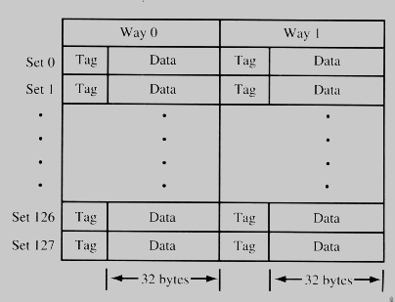
Structure of 8KB instruction and data cache
Each entry in a set has its own tag.
Tags in the data cache are triple ported, used for
U pipeline
V pipeline
Bus snooping
Bus snooping or bus sniffing is a scheme by which a coherency controller (snooper) in a cache (a snoopy cache) monitors or snoops the bus transactions, and its goal is to maintain a cache coherency in distributed shared memory systems.

Slide 18
Instruction Cache of Pentium
Instruction cache is write protected to prevent self-modifying code.
Tags in instruction cache are also triple ported
Two ports for split-line accesses
Third port for bus snooping

Slide 19
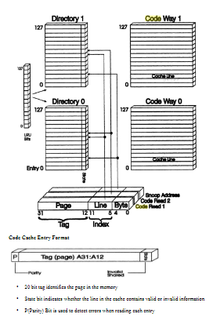
Code Cache organization

Slide 20
Split-line Access
In Pentium (since CISC), instructions are of variable length(1-15bytes)
Multibyte instructions may staddle two sequential lines stored in code cache
Then it has to go for two sequential access which degrades performance.
Solution: Split line Access

Slide 21
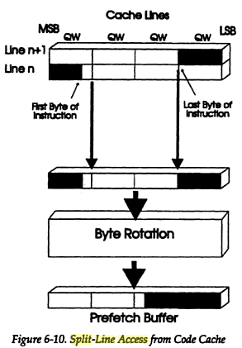
Split-line Access

Slide 22
Split-line Access
It permits upper half of one line and lower half of next to be fetched from code cache in one clock cycle.
When split-line is read, the information is not correctly aligned.
The bytes need to be rotated so that prefetch queue receives instruction in proper order.

Slide 23
Instruction & Data Cache of Pentium
Parity bits are used to maintain data integrity
Each tag and every byte in data cache has its own parity bit.
There is one parity bit for every 8 byte of data in instruction cache.

Slide 24

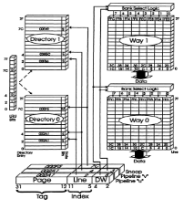
Data Cache organization

Slide 25
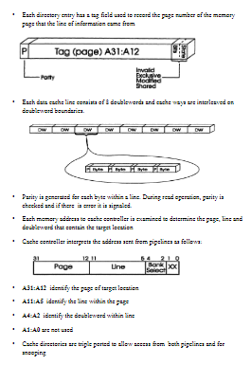
Data Cache organization

Slide 26
Advantages of having Separate Code and Data Caches
Separate caches efficiently execute the branch prediction.
Caches raise system performance i.e. an internal read request is performed more quickly than a bus cycle to memory.
Separate caches also reduce the processor’s use of the external bus when the same location are accessed multiple times.
Separate caches for instructions a and data allow simultaneous cache look-up.
Up to two data references and up to 32 bytes of raw op-codes can be accessed In one clock.

Slide 27
Branch Prediction
Branch prediction is used to predict the most likely set of instruction to be executed and prefetch to make them available to the pipeline as and when they are called.
Hence the pentium processor incorporate a branch target buffer (BTB), which is an associative memory used to improve the performance if it takes the branch instrction.
Branch instructions of pentium processor change the normal sequential control flow of the program execution and may stall the pipelined execution in the pentium system.

Slide 28
Branches instruction is of two types i.e. conditional and unconditional branch.
During the conditional branching, the CPU has two wait till the execution stage to determine whether the condition is satisfied or not.
When the condition satisfies, a branching is to be taken using branch prediction algorithm for speed up of the instruction execution.
In pentium Processor, BTB can have 256 entries which contains the branch target address for previously executed branches.
The BTB is four ways set associative on-chip memory.

Slide 29
Whenever the branching occurs, the CPU checks the branch instruction address and the destination address in the BTB.
When the instruction is decoded, the CPU searches the branch target buffer to decide whether any entry exists for a corresponding branch instruction.
If BTB is hit, i.e. if BTB exist such entries, then the CPU use the history to decide whether the branch will be taken or not.
If the entry exist in its previous history in BTB to take the branch, the CPU fetches the instruction from the target address and decodes them.
If the branch prediction is correct, the process continue else the CPU clears the pipeline and fetches from the appropriate target address.

Slide 30
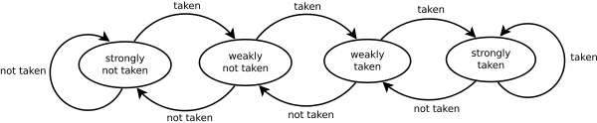
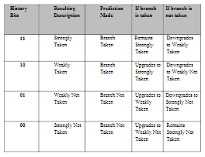
Branch Prediction

Slide 31
Floating point Unit
The Pentium contains an on chip floating point unit that provides significant floating point performance advantage over previous generations of processors.
Providing the coprocessor onto the same chip as the processor, Pentium allows faster communication and quicker execution.
Thus many floating point instructions requires fewer clock cycles that the previous 80X87.

Slide 32
Floating Point Pipeline
The floating point pipeline of Pentium consists of eight stages which are used to speedup the execution of floating point unit. Hence, it is necessary floating point pipeline.
These are prefetch, first decode, second decode, operand fetch, first execute, second execute, write float and error reporting.
Floating point unit has eight stage pipeline which gives a single cycle execution for many of floating point instructions such as floating adds, subtract, multiply and compare

Slide 33
The stages and their functions are given below:
PF (prefetch): Instructions are prefetched from the on chip instruction cache.
D1 (first decode): Instruction decode to generate control word. A single control word causes direct execution of an instruction and complex instruction require micro-coded control sequence.
D2 (second decode): Address of memory resident operand are calculated.
Ex (operand fetch): In this stage, register read, memory read or memory write operation is performed to access an operand as required by the instruction.

Slide 34
X1(first execute): In this stage, the floating point data from register or memory is written into floating point register or memory is written into floating point register and converted to floating point format before loaded into the floating point unit.
X2(second execute): In this stage, the floating point operation is performed by floating point unit.
WF(write float ): In this stage, results of floating point operation are rounded and then written to the destination floating point register.
ER(error reporting): In this stage, if any error is occurred during floating point execution, then it is reported and FPU status word is updated.

Slide 35
Floating point Exception
There are six floating point exception condition while execution floating point instructions are available in status word register of Pentium FPU.
These exceptions are:
Stack overflow or underflow
Invalid arithmetic operation
This exception occurs when stack fault flag (SF) of the FPU status word indicates the type of operation i.e. stack overflow or Underflow for SF=1 and an arithmetic instruction has encountered an invalid operand for SF=1.

Slide 36
Divide by zero: This exception occurs whenever an instruction attempts to divide a finite non-zero operand by 0.
De-normalized operand exception: The de-normal operand exception occurs if an arithmetic instruction attempts to operate on a de-normal operand or if an attempt is made to load de-normal single or double real value into an FPU register.
Numeric flow exception: This exception occurs whenever the rounded result of an arithmetic instruction is less than the smallest possible normalized, finite value that will fit into the real format of the destination operand.
Inexact result (Precision) Exception: This exception occurs if the result of an operation is not exactly representable in the destination format.

Slide 37
Cache Coherency in Multiprocessor System
When multiple processors are used in a single system, there needs to be a mechanism whereby all processors agree on the contents of shared cache information.
For e.g., two or more processors may utilize data from the same memory location,X.
Each processor may change value of X, thus which value of X has to be considered?

Slide 38
Cache coherency in Multiprocessor Systems
If each processor change the value of the data item, we have different(incoherent) values of X’s data in each cache.
Solution : Cache Coherency Mechanism

Slide 39
Cache Coherency
Pentium’s mechanism is called MESI (Modified/Exclusive/Shared/Invalid)Protocol.
This protocol uses two bits stored with each line of data to keep track of the state of cache line.

Slide 40
Cache Coherency
The four states are defined as follows:
Modified:
The current line has been modified and is only available in a single cache.
Exclusive:
The current line has not been modified and is only available in a single cache
Writing to this line changes its state to modified

Slide 41
Cache Coherency
Shared:
Copies of the current line may exist in more than one cache.
A write to this line causes a writethrough to main memory and may invalidate the copies in the other cache
Invalid:
The current line is empty
A read from this line will generate a miss
A write will cause a writethrough to main memory

Slide 42
Cache Coherency
Only the shared and invalid states are used in code cache.
MESI protocol requires Pentium to monitor all accesses to main memory in a multiprocessor system. This is called bus snooping.

Slide 43
Cache Coherency
Inquire cycles examine the code cache as well (as code cache supports bus snooping)
Pentium’s address lines are used as inputs during an inquire cycle to accomplish bus snooping.

Slide 44
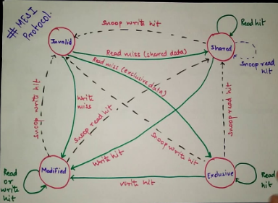
MESI Protocol

Slide 45
Comparison of 80386 and Pentium
80386 | Pentium
32- bit integer core CPU with 32 bit Data bus | 32 bit CPU with 64-bit data bus
No superscalar architecture and single cycle execution | Superscalar architecture i.e. two pipelined Integer Units are capable of 2 Instructions per clock
No internal cache available for data and code | Separate 8KB code and 8KB data cache available
80386 does not support branch prediction | Advanced design feature i.e. Dynamic branch Prediction
One integer ALU | Two integer ALU
Operating frequency are 20 MHz to 66 MHz | Operating frequency 60 MHz and more
FPU is non- pipelined as it is an external device 80387 | FPU is pipelined as it is in built in Pentium FPU

